Slide 1
Iris Classification
Submitted by: Chandan Bhattacharya

Slide 2
Project Overview
Objective:
The objective of this project is to build a machine learning model to classify iris flowers into one of three species (Iris-setosa, Iris-versicolor, Iris-virginica) based on their physical features.
Background:
The Iris dataset is a well-known dataset in the machine learning community, often used for testing new algorithms and learning techniques.

Slide 3
The Iris Dataset
Dataset Description:
The Iris dataset consists of 150 samples, each with four features: sepal length, sepal width, petal length, and petal width.
The dataset is divided into three classes: Iris-setosa, Iris-versicolor, and Iris-virginica.
Key Features:
Sepal Length, Sepal Width, Petal Length, Petal Width

Slide 4
Modeling Approach
Algorithms Used:
We tested several algorithms, including Logistic Regression, Decision Tree, and K-Nearest Neighbors (KNN), to classify the iris species.
Model Selection:
The best model was selected based on performance metrics such as accuracy and F1 score.

Slide 5
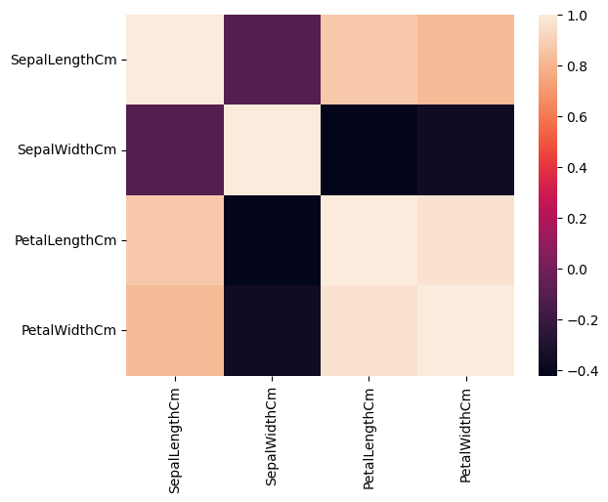
Relationship in the Dataset

Slide 6
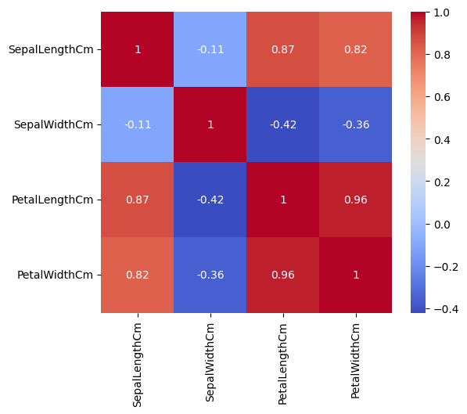
Heatmap Views

Slide 7
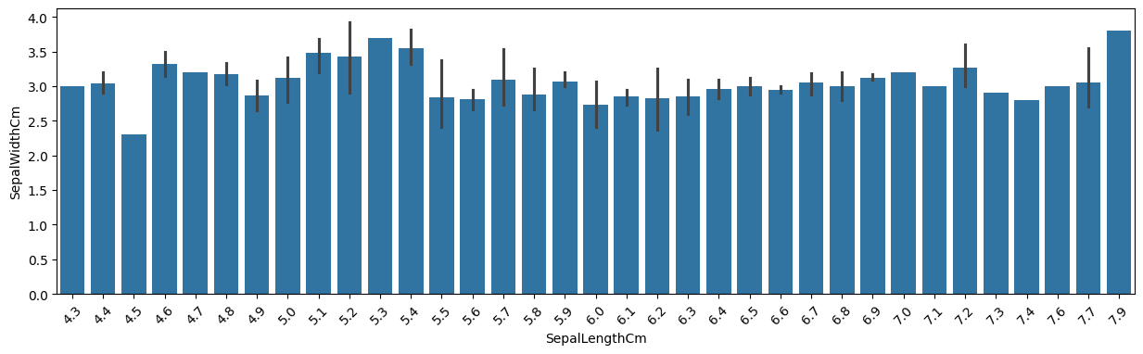
Sepal Length(Cm) and Sepal Width(Cm) Bar Chart Views

Slide 8
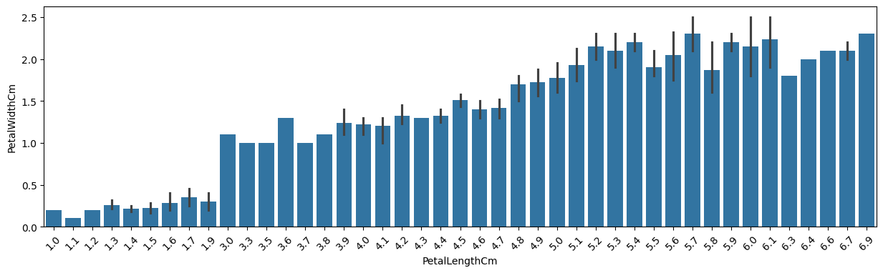
Petal Length(Cm) and Petal Width(Cm) Bar Chart Views

Slide 9
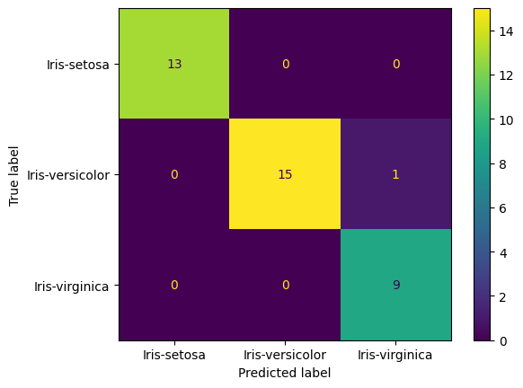
Logistic Regression Analysis
Accuracy: 0.9736842105263158

Slide 10
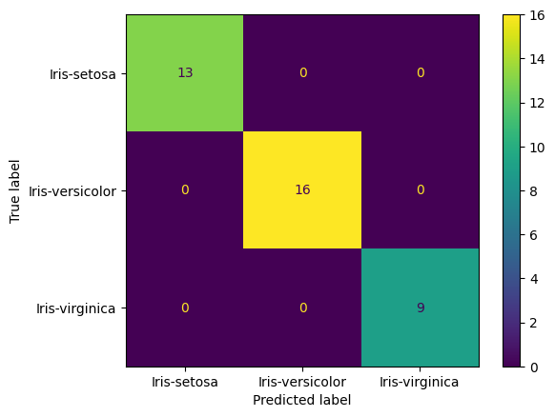
K-Nearest Neighbour Classification
Accuracy: 1.0

Slide 11
Decision Tree Classification
Accuracy: 0.9736842105263158

Slide 12
Random Forest Classifier
Accuracy: 1.0

Slide 13
Support Vector Machine (SVM)
Accuracy: 0.9736842105263158

Slide 14
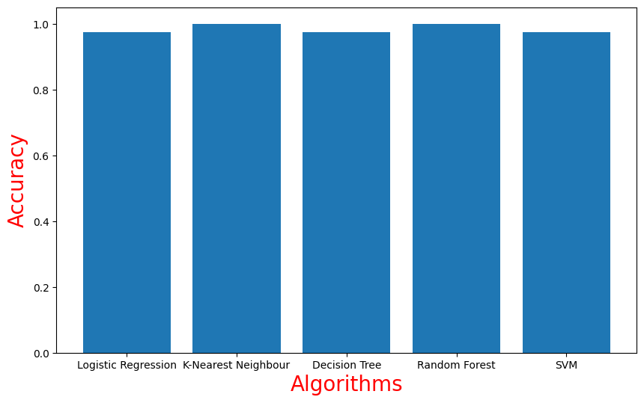
Comparison of Performance

Slide 15
Model Evaluation
Evaluation Metrics:
We used accuracy, precision, recall, and F1 score to evaluate the performance of our models.
Best Model:
The Decision Tree model achieved accuracy of 100% to 97% on the test dataset.

Slide 16
Results and Insights
Key Results:
The model was able to accurately classify the iris species, with a high degree of precision and recall.
Insights:
Petal length and width were found to be the most significant features in distinguishing between species.

Slide 17
Conclusion
Summary:
This project successfully demonstrated the use of machine learning for classifying iris species.
Future Work:
Future improvements could include exploring more advanced models and applying the techniques to other datasets.

Slide 18
Thank You

